Slide 1
TITLE: A Jewish Solution to the Synoptic Problem Mark as an early Jewish Targumist - predecessor of the style of the early Targums

Slide 2
Outline of the presentation: Brief introduction to the ”SYNOPTIC PROBLEM” l. The objective FACTS to be explained ll. The context of TARGUMISTIC STYLE of 1st century III. The significance of HEBRAISMS in Greek lV. The possibility of STATISTICAL PROOF V. The context of the EXTERNAL HISTORICAL CONTEXT Conclusions

Slide 3
Brief introduction to the ”SYNOPTIC PROBLEM”

Slide 4
Introductory comments: A brief glance at the history of theories
Attempts to solve the “SYNOPTIC PROBLEM”

Slide 5
What is the Academic Problem called the “SYNOPTIC” PROBLEM? Syn = together optic = seeing

Slide 6
The unusual COMBINATION of SIMILARITIES and DIFFERENCES between the first three Gospels of the NT

Slide 7
WHO has “problems”?
Conservative traditional Bible scholars
are often disturbed
over the differences between the gospels.
and some try to explain the differences away.
Some even seek to create
“Harmonies” of the gospels
where attempts are made to fit all three accounts
together into one account.

Slide 8
Comfort from Simon Greenleaf – a Messianic Jewish professor at Harvard Law School in mid-1800s
”If I have four witness in court, and they all agree perfectly,
I know they are lying.”
The ”ring of truth”
is when the testimonies agree in general,
but not in all the specifics."

Slide 9
WHO else has “problems”?
Liberal modernist Bible scholars
are often disturbed
over the similarities between the gospels,
and some try to explain the similarities away.
Some even throw out
all of the miraculous elements
and leave only a core of ethical teachings,
- even omit Jesus altogether as irrelevant.

Slide 10
RESULTS: consider the conclusions of the “JESUS SEMINAR” in California - they take votes on the reliability of the sayings of Jesus
Possible - a couple sayings may be authentic
Improbable - some
Highly improbable - several hundred, the vast majority
Impossible - some

Slide 11
Skeptical note:
The fewer the facts,
The more the theories.

Slide 12
Consider some THEORIES the attempts to explain the differences and the similarities

Slide 13
The early uncritical acceptance of two simple assumptions: 1. the chronological order, was thought to be Matthew, Mark, Luke, - as found in the lists from the fourth century onward, -e.g., the order used in Jerome’s Latin Vulgate translation 2. each wrote independently.

Slide 14
CHALLENGE to the uncritical acceptance of the simple assumptions: In the early 400s Luke is still considered the last of the three, but not independent, he copied from both Mt and Mk

Slide 16
This constituted the beginning of the theory of “INTERDEPENDENCE” = COPYING from one or both of the others

Slide 17
This THEORY of INTERDEPENDENCE still reigns supreme now 1,600 years later.
Indeed, it is considered a solid fact.
But it exists in a grand confusion
of many varieties.
Very few scholars still deny any copying at all.

Slide 18
WHO copied from WHOM? WHY? so many differences: - so many changes? - so many additions? - so many omissions?

Slide 19
Who even cares? Just consider: If scholars get the sequence wrong, What is the RESULT? Baseless, erroneous, misleading speculations about the reasons why who changed whom.

Slide 20
ANOTHER OPTION - from the late 1700s: Mark is the last! and he copied from both Mt and Lk

Slide 22
1776 – Johann Jakob GRIESBACH (1745-1812)
Griesbach was the first to publish
the Greek gospels in parallel columns
- in order to facilitate comparisons between the texts

Slide 23
Sample of Griesbach’s formatting of the Greek texts
Mat
Mar
Luk

Slide 24
THE reigning theory today since the 1830s MARK is the first and Mt and Lk copied from both Mark and from Q, i.e., from another conjectured source Quelle/source

Slide 25
Q?

Slide 26
WHY the need for this additional source?
Answer: the inability of the 19th century minds to explain
why Mark is MISSING so very much valuable historical information
1. contained in common by both Luke and Matthew
but not found in Mark.
2. contained independently
in Luke separately and in Matthew separately
but not found in Mark.

Slide 27
CHALLENGE to a 19th century European mindset
In the FIRST CENTURY A.D.Middle Eastern context
does a mindset exist
which could explain how Mark decided
To abbreviate his source so radically?
To expand the wording of his chosen limited text so greatly?

Slide 28
END of INTRODUCTION
Temporarily we turn our backs on the above theories
in order to take
Take a hard look at some hard FACTS in the texts

Slide 30
Outline of the presentation: Brief introduction to the ”SYNOPTIC PROBLEM” l. The objective FACTS to be explained ll. The context of TARGUMISTIC STYLE of 1st century III. The significance of HEBRAISMS in Greek lV. The possibility of STATISTICAL PROOF V. The context of the EXTERNAL HISTORICAL events. Conclusions

Slide 31
I.The objective FACTS to be explained

Slide 32
A. percentages of shared and unshared materials B. word counts of shared and unshared materials
I. FACTS to be noted and weighed
In order to answer the question:
Which writer is adapting whom?
For what purpose?

Slide 33
A. PERCENTAGE of each gospel containing text which is either: 1. independent 2. shared with one 3. shared with both

Slide 37
PERCENTAGES

Slide 38
B. ACTUAL WORD COUNTS of the various texts - independent words - shared words

Slide 39
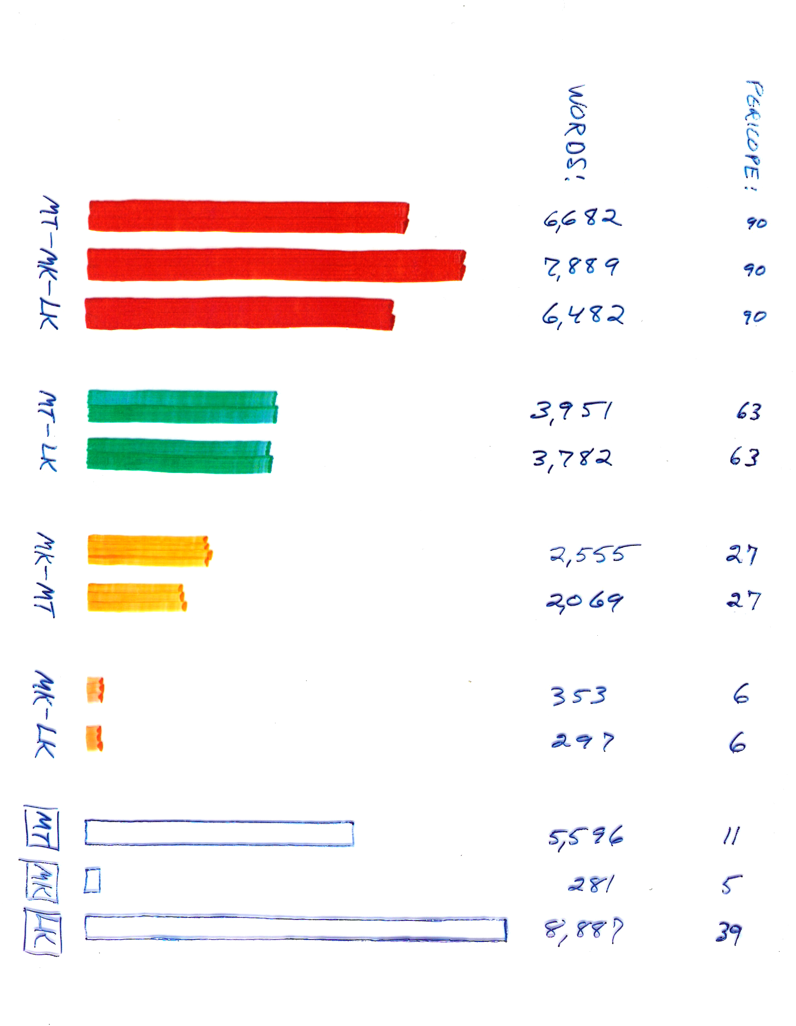
Triple Tradition
Double: Mt-Lk
Double: Mk-Mt
Double: Mk-Lk
Independent

Slide 40
Often ignored fact to be explained somehow:
Mark is the LONGEST Gospel…
in terms of wordiness
in shared materials (Triple Tradition)

Slide 41
Word counts in TRIPLE TRADITION contexts – from the least words to the most words
Luke 6,482 Greek words
Matthew 6,682 Greek words
Mark 7,889 Greek words – the MOST WORDS:
Mark has 1,407 words more than Lk.
Mark has 1,207 words more than Matt.

Slide 43
Another difference:
Mark is the FASTEST Gospel!
See Robert Morgenthaler:
Statistische Synopse

Slide 44
Word frequencies counted by Morgenthaler note “euthus” as an adverb

Slide 45
Euthus =“and immediately” 1 time in Luke 42 times in Mark!

Slide 46
Mark’s speeded-up record is more dramatic than Luke But WHY:?
Mark is the only writer who entitles his work as being
the “Gospel” = Good News!
about which he is excited!

Slide 47
So much for publically observable FACTS Now back to THEORY

Slide 49
Outline of the presentation: Brief introduction to the ”SYNOPTIC PROBLEM” l. The objective FACTS to be explained ll. The relevance of TARGUMISTIC STYLE of 1st century III. The significance of HEBRAISMS in Greek lV. The possibility of STATISTICAL PROOF V. The relevance of the EXTERNAL HISTORICAL CONTEXT Conclusions

Slide 50
FACTS have been noted now EXPLANATION begins A THEORY to be justified

Slide 51
ll. Theory: The relevance of context: TARGUMISTIC STYLE in 1st century A.D.

Slide 52
Methodology: CONSIDER CONTEXT.

Slide 53
WHO, IN THOSE DAYS, TWO THOUSAND YEARS AGO, has this style, in the case of parallel texts, 1. to SHORTEN a text in overall length 2. to EXPAND the text (within that limited selection) because of the aim of DRAMATIZATION?

Slide 54
Is a theory available which is supported by the facts?

Slide 55
Theory: A Jewish solution to the Synoptic Problem: MARK, as an early Jewish “Targumist”

Slide 56
Definitions of Targum
Oxford:
Noun:
an ancient Aramaic paraphrase or interpretation of the Hebrew Bible,
of a type made from about the 1st century AD
when Hebrew was declining as a spoken language.

Slide 57
Definitions of Targum
Britannica:
Targum, (Aramaic: “Translation”, or “Interpretation”),
any of several translations of the Hebrew Bible or portions of it
into the Aramaic language.
The word originally indicated a translation of the Old Testament
in any language
but later came to refer specifically to a Aramaic translation.

Slide 58
Targums Onkelos and Jonathan
Written around 100 AD
Earliest manuscripts around seventh century AD

Slide 59
Gospel of Mark just slightly earlier than Onkelos
Written in the first century AD
Earliest manuscripts from the fourth century AD

Slide 60
CONTEXT – less than 50 years apart
Mark (1st century)
is just barely a predecessor of
Targum Onkelos (early 2nd century”)

Slide 61
IDENTICAL: Mark and Onkelos are retelling events that were written in a semitic language.

Slide 62
DIFFERENT: Onkelos is retelling in Aramaic – from Hebrew Mark is retelling in Greek - from Greek based on Hebrew

Slide 63
OVERLAPPING CONTEXT Consider Jewish authors, earlier than Onkelos, who were partly contemporaneous with Mark Philo: ca.20BC – 50AD Josephus: ca 40 AD -100AD

Slide 64
Mark demonstrates striking similarity, even identity of style with these fellow Jewish writers of the time

Slide 65
See Philo, who rewrites the Biblical Hebrew Balaam story, and See Josephus, who rewrites the Biblical Hebrew Jonah story.

Slide 66
EXAMPLES of their style:
Selecting limited material and retelling it with the aim of dramatizing it with word effects designed to attract and maintain excitement – like introducing a Lukan one-time phrase ”and immediately” 42 times.
Deliberately rewording the materials by flipping known order of words, of sentences and even of paragraphs – to attract attention.
Expanding by adding new material via pickups of known expressions - (in this case from the Pauline letters, because of familiarity during the months during which Mark traveled together with Paul).

Slide 67
We have looked at these facts: 1. percentages of shared and unshared materials 2. word counts of shared and unshared materials
FACTS to be noted and weighed
in order
to answer the question:
Which writer is adapting whom?
For what purpose?

Slide 68
We have come up with a claim that the JEWISH TARGUMIST STYLE OF RETELLING STORIES is the best candidate for an explanation of observable facts of the 1.percentages of words in duplicated stories and the 2. word count differences in the parallels

Slide 70
Outline of the presentation: Brief introduction to the ”SYNOPTIC PROBLEM” l. The objective FACTS to be explained ll. The relevance of TARGUMISTIC STYLE of 1st century III. The significance of HEBRAISMS in Greek lV. The possibility of STATISTICAL PROOF V. The relevance of the EXTERNAL HISTORICAL CONTEXT Conclusions

Slide 71
III. The significance of Hebraisms in the Greek texts of the Gospels

Slide 72
The HEBREW FACTOR
Enters the scene

Slide 73
Entering into this complex scene
TWO MEN:
Lindsey: an American,
a Baptist pastor
Flusser: a Czechoslovakian Jew,
a classical philologist of Greek

Slide 74
Lindsey Flusser Bivin Safrai

Slide 75
Robert Lindsey
To provide a Hebrew New Testament
for the Hebrew speakers in his congregation,
he starts to translate Mark from Greek into Hebrew

Slide 76
Why did Lindsey start with Mark?
Because
he had been taught the theory
that Mark is first.

Slide 77
David Flusser
As a philologist of classical Greek literature,
who had immigrated to Israel,
Flusser wanted to read everything
written in Greek by Jews
so
he reads the New Testament.
He senses the Hebraic character
of Luke’s Greek

Slide 78
They were both concerned with FACTS, publically observable FACTS, as they relate to ”Hebrew-ease”

Slide 79
“Hebrew-ease”?
This new expression refers to
the ease of translating a Greek text into Hebrew.
This occurs when the translator gets the suspicion that he is making a translation into Hebrew of what was actually originally a Hebrew text where word order and concepts are more natural in Hebrew than in the Greek text being translated.

Slide 80
FACTS: noted by Lindsey and Flusser
Mark is ERRATIC
sometimes easy, but sometimes difficult to translate into Hebrew.
2. Luke is CONSISTENTLY easier
to translate into Hebrew, uninfluenced by the presence or absence of parallels.
3. Matthew is INCONSISTENT
- because he is easy to translate, like Luke,
- UNLESS Mark has the same story because
then MT becomes as erratic as Mark.

Slide 81
THEORY: hit on by Lindsey
Mark is responsible
for this change in Matthew,
i.e., Matthew is following Mark’s wording.
Matthew is also following Mark’s story order
But Luke is independent!
Lk is unaffected by the wording of Mk or Mt, and
is easier to translate into Hebrew than they are
whether they have the story or not.

Slide 82
This is the unintentional, accidental discovery made in common by a translator (Lindsey) and a philologist (Flusser)
LUKE is INDEPENDENT !?!
This realization makes the most sense of the facts
faced by a translator and a philologist.

Slide 83
Jerusalem School of Synoptic Research Resulting “JSSR” THEORY: A Hebrew Matthew is first, and was soon roughly translated into a Hebraic Greek. Then, in linear sequence, Luke > Mark > Matthew used this Greek translation of a Hebrew base.

Slide 85
Eusebius (4th century):Ecclesiastical History, Book 3, Chapter 39. The PAPIAS QUOTE:
16. But concerning Matthew
he [Papias 2nd century] writes as follows:
“Matthew wrote the oracles
in the Hebrew language
and every one interpreted them
as he was able.”⁹⁶³⁻⁴

Slide 87
Back again from Theory to publically observable FACTS

Slide 89
Outline of the presentation: Brief introduction to the ”SYNOPTIC PROBLEM” l. The objective FACTS to be explained ll. The relevance of TARGUMISTIC STYLE of 1st century III. The significance of HEBRAISMS in Greek lV. The possibility of STATISTICAL PROOF V. The relevance of the EXTERNAL HISTORICAL CONTEXT Conclusions

Slide 90
lV. The possibility of statistical “proof”of a theory

Slide 91
Additional FACTS
The following facts
need to be observed
and then weighed
in terms of relevance
to the questions:
Which writer is adapting whom?
For what purpose?

Slide 93
Summary chart word counts of each gospel in different contexts
BOLD CLAIM:This special chart appears
for the first time in the history of synoptic research.
The total word count of each gospel is divided into five parts:
WHITE, the words in independent material not shared the others
RED, the words in material present in all three gospels
and the words that are shared by two of the gospels, but not by the third
ORANGE (Mk-Lk) and
YELLOW (Mt-Mk) and
GREEN (Mt-Lk),

Slide 95
The reason for this discovery being first
The reigning theories have prevented anyone else
from hitting on the idea
that such minute detail of attention
could reveal anything relevant in support of their theories.
They were right to think so,
because the other theories are
threatened by this hard evidence.

Slide 96
VERBAL IDENTITES between parallel texts
An additional collection of publicly-observable, reproducible FACTS

Slide 97
What is the relevance, if any, of the study of the VERBAL IDENTITIES between the parallel texts?

Slide 98
Who is using Whom? What is the relation of verbal identities to the issue of potential statistical proof of the order of dependency?

Slide 99
PROBLEM! HOW TO MEASURE percentages of “verbal identity”?

Slide 100
How to count words that exist in common in two or more documents?

Slide 101
How move from simple EXISTENCE of common words to any possible SIGNIFICANCE of these lists?
Is it possible to draw any conclusions
in terms of direction of dependence
between the two documents being compared?
Which author is dependent on the other?

Slide 102
If two authors are telling the same story they will naturally be using many of the same words, SO how can common words have any significance in terms of who is dependent on whom?

Slide 103
Here we are helped by Swiss precision. See Robert Morgenthaler’s STATISTICHE SYNOPSE TREMENDOUS PATIENCE IN COUNTING WORDS

Slide 104
Explanation of ”ifs” = identical in form and sequence based on German ”ffi” = form und folge identisch

Slide 105
Single common words were NOT counted. 1. Only if two or more identical words 2. occurred in the identical order were they counted. He discovered that anywhere from two to thirteen words can be found in the identical order when comparing two gospels with each other.

Slide 106
It should be clear that the likelihood of this happening by chance (because of a similar topic) is highly unlikely.

Slide 107
It is more likely that one is dependent on the other … but in WHICH DIRECTION?

Slide 108
HYPOTHESIS: Statistical proof of direction of dependence is possible.
Hard EVIDENCE,
via publically available, reproducible FACTS,
is available.
Thanks to Morgenthaler!

Slide 109
Note green columns of Lk and Mt

Slide 110
Triple Tradition
Double: Mt-Lk
Double: Mk-Mt
Double: Mk-Lk
Independent

Slide 111
VERBAL IDENTITY In Double Tradition:Lk-Mt 50% of Lukan wording survived in Matthew
FACTS

Slide 112
But the LK-MT ORDER of the stories is a different matter - a rather radically different location of the stories

Slide 113
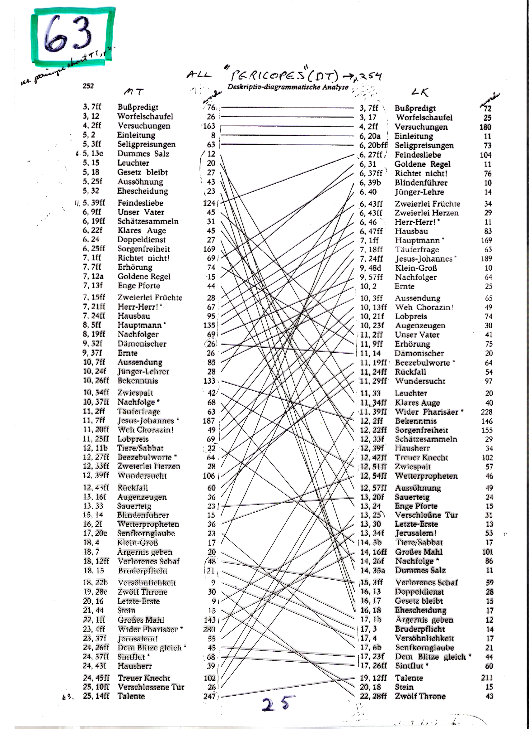

Slide 114
Note the yellow/yellow colums of Mk and Mt

Slide 115
Triple Tradition
Double: Mt-Lk
Double: Mk-Mt
Double: Mk-Lk
Independent

Slide 116
FACTS VERBAL IDENTITY In Double Tradition:Mk-Mt 50% Mk wording has survived in Mt

Slide 117
Note red columns of “Triple Tradition” Lk-Mk-Mt

Slide 118
Triple Tradition
Double: Mt-Lk
Double: Mk-Mt
Double: Mk-Lk
Independent

Slide 119
Mark is longer than either Luke or Matthew

Slide 120
VERBAL IDENTITY of ”Double Tradition”: Mk-Mt 50% of Markan wording has survived in Matthew.

Slide 121
BUT also WITHIN Triple Tradition (Lk)-Mk-Mt 50% of Markan wording has survived in Matthew.

Slide 122
FACT: no previous researcher has ever bothered to count word relationships WITHIN Triple Tradition WHY?

Slide 123
WHY?
BECAUSE such counting
seemed irrelevant to their theories,
OR
Even potentially threatening.

Slide 124
Just consider: Mt’s AMAZING 50% CONSISTENCY in three situations:
LUKE –> Mt 50% of Luke’s wording
MARK –> Mt 50% of Mark’s wording
MARK –> Mt also within triple tradition 50% of Mark’s wording

Slide 125
Matthew is consistent not only in terms of the wording of other parallel texts, But Matthew maintains this consistency by following also the story order of Mark. Therefore he is so 1. similar to Markan order and so 2. very different from Luke’s order.

Slide 126
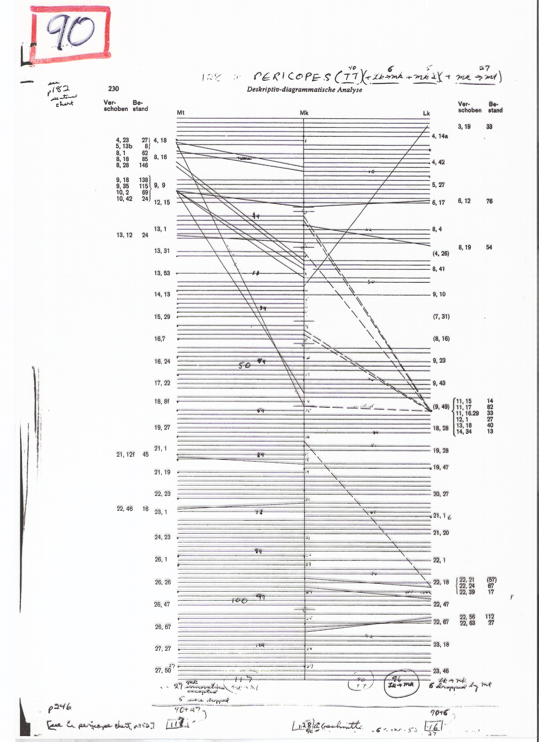
SIMILAR ORDER
In the Triple Tradition
i.e., the shared stories
Lk-Mk-Mt

Slide 127
Not similar
Story order
in Double Tradition
Mt-Lk
In DT

Slide 128
Legitimate conclusion: This repeated consistency indicates that Mt is the secondary writer in each of three pairs of parallels since he is maintaining the same consistent style in relating to the other parallel text in each of the three comparisons. 1. Lk > Mt 2. Mk>Mt 3. Mk>Mt within Triple Tradition* *no scholar has previously noted this consistency within TT.

Slide 129
Can statistics contribute to proof of linear sequence?

Slide 130
HYPOTHESIS: It is possible to provide statistical proof of the direction of dependence within a linear sequence of the Gospels.
Solid EVIDENCE,
via
publically observable, reproducible FACTS,
is available.

Slide 131
A totally new precision of counting of statistical percentages WITHIN Triple Tradition
A preview of NEWLY DISCOVERED FACTS (in rounded percentages)
The empirically observable facts are: 1. 32% of Mk's text within Triple Tradition consists of Lk wording
2. 50% of Mt's text within Triple Tradition consists of Mk wording.
3. 20% of Mt's text within Triple Tradition consists of Lk wording.
These are facts which anyone can reduplicate,
but no one had thought to count.

Slide 132
Why no one counted these facts is because they appeared to be irrelevant to the dominant theories.
The internal facts of the word relationships within Triple Tradition become esp. relevant in terms of checking theories of linear dependence between the gospels such as the Lindsey/Flusser theory of Lukan independence of the other gospels … the theory that, of our gospels, the first was Luke followed by Mark and then by Matthew.

Slide 133
The statistics are theoretically capable of disproving all six options of linear dependence, and other theories as well.
Tension ran high during the research as to what would be the results!
In fact the statistics did disprove five of the six theories,
and only the LK>MK>MT sequence was supported.

Slide 134
But a sudden unexpected challenge to the theory of linear sequence did occurr during the research. The research threatened to negate also the remaining sixth option: the theory of the Lk-Mk-Mt sequence!

Slide 135
Seeming failure of confirmation for a linear sequence of the gospel texts
The empirically observable amount of 20% percentage appeared to contradict the theory of Lindsey and Flusser about Lk priority
because 50% of 32% is only 16% of Mt.
According to the theory,
only 16% of Mt Triple Tradition
should consist of Lukan wording.

Slide 136
Again, the cold harsh statistical truth within TRIPLE TRADITION was that a full 20% of Mt's text had Lk wording.

Slide 137
Seeming Failure? When starting with Luke’s text within Triple Tradition
1. FACTS: 32% of Luke’s text remains in Mark 50% of Mark’s text in Matthew
and 20% of Luke’s text remains in Matthew.
2. THEORY’S PREDICTION:
according to the theory of Lk-Mk-Mt being in sequence
only 16% of Lukan wording should be left!
This is because 50% of 32% = 16% , NOT 20%!
SO, if indeed 20% of Lukan wording remains via Mark into Matthew,
this would be a failure of the hypothesis!

Slide 138
Yet again, in the case of the theory of linear dependence, only 16% of Luke’s wording should be found remaining in Matthew (32%x50% = 16%). This result indicated a tramatizing failure, as is obvious from the repetitions in this PPT!

Slide 139
VERBAL IDENTITY FACTS: Mt-Lk WITHIN Triple Tradition = 20% of Mt text remains in Lk, NOT the predicted 16%!
FACT: potential DESTRUCTION of the theory

Slide 140
The clue of the Eureka moment - VIA MARK!
In order for the statistics to be relevant,
they had to be counts of
what survived of Lukan wording in Matthew
VIA MARK.
IF
the wording had come from Luke into Matthew in any other way,
they were irrelevant to the calculation.

Slide 141
It became necessary to eliminate all ifs words that were common to MT-LK, but not found in MK. The count revealed that 4% of the Lukan-Matthean parallel texts consisted of words NOT found in MARK! The calculation proved that the theory of linear dependence of LK>MK>MT was correct after all since it had predicted the 16%. 20%-4% = 16%

Slide 142
“MINOR” AGREEMENTS
In the scholarly world these agreements of LK - MT have been a problem for MK priority – as to their origin. The agreements have been sidelined as unimportant and named “MINOR” AGREEMENTS.
It turns out that they are minor in number, but MAJOR in significance, since they clinch the argument for the only one of the six options of linear sequence that survives:
LK>MK>MT

Slide 143
VERBAL IDENTITY WITHIN Triple Tradition Mt-Mk-Lk ONLY 16% of Lukan wording is left in Matthew (VIA Mark)
FACTS

Slide 144
The ”Minor Agreements” are exactly what establish the Lk-Mk-Mt linear relationship, via the surprising “perfection” of the statistical evidence.

Slide 146
Outline of the presentation: Brief introduction to the ”SYNOPTIC PROBLEM” l. The objective FACTS to be explained ll. The context of TARGUMISTIC STYLE of 1st century III. The significance of HEBRAISMS in Greek lV. The possibility of STATISTICAL PROOF V. The relevance of the EXTERNAL HISTORICAL CONTEXT Conclusions

Slide 147
V. Relevance of the EXTERNAL HISTORICAL CONTEXT

Slide 148
The INTERNAL CONTEXT of publically observable facts within the texts can be too complex to be grasped immediately, therefore it will be worth looking at the EXTERNAL CONTEXT both politically and religiously 2000 years ago

Slide 149
This last step in the argument comes from publically observable facts in the realm of universally uncontested facts of the EXTERNAL HISTORICAL CONTEXT

Slide 150
The INCONTESTABLE and therefore UNCONTESTED FACTS of EXTERNAL HISTORICAL CONTEXT upon which ALL agree concerning two basic trends of the time.

Slide 151
Note: TWO incontestable historical developments
Tension was growing between JEWS and JEWS,
even hatred against Jesus and his followers.
The hatred led to Jesus’ crucifixion in the 30s A.D. and was followed by ongoing tension between the Jewish followers of Jesus, and the Jewish followers of Sadducees and Pharisees - most of whom opposed the Messianic Jewish followers of Jesus and martyred some of them.
.

Slide 152
2. Hatred was growing between JEWS and ROMANS, between the subjugated Jews and the cruel Roman rulers. The hatred led to rebellion in 66 AD and destruction of the temple in 70 AD

Slide 153
How are these growing tensions reflected in the synoptic gospels?
What do the gospel writers
want you, the reader
to FEEL about the Romans and about the Judean leaders as groups,
and also
to FEEL about individuals such as Pilate, the Roman governer, and Herod, the Jewish ruler, and Caiaphas, the Jewish High Priest?

Slide 154
Which gospel is more irenic, and which is more aggressive? … as regards Jews against Jews and Jews against Romans?

Slide 155
The evidence is in a linear progression:
from relatively irenic Luke,
to an abrasive Mark,
to an aggressive Matthew.
This sequence reflects the ORDER OF THEIR COMPOSITION
as exhibiting the growing tensions in the time of Jesus.

Slide 156
It would appear that a known chronological progression is being reflected in terms of the ever growing anti-Roman and anti-Christian sentiments in context of those days. It would therefore seem logical that the most irenic account is the earliest and the most aggressive account is the latest.

Slide 157
There is yet another factor to be considered in the matter of sequence of the gospels: the opening lines of each gospel
What are the implications of
the differing emphases
that are clearly stated in the opening lines of each document?

Slide 158
A context sensitive quest to find the actual sequence by considering the opening lines of each
ACTS of Jesus - Lk
GOSPEL of Jesus - Mk
GENEALOGY of Jesus – Mt
The WORD of GOD is Jesus - Jn

Slide 159
Speculations re sequence from opening lines
His deeds RECORDED (Lk)
… the acts of Jesus
2. Then His significance DRAMATIZED (Mk)
… the exciting good news - gospel
3. Then His heritage PROVEN (Mt)
… geneaology comes first
4.Then His identity EXALTED (Jn)
… in the beginning was the Word
… and the Word was God.

Slide 161
Outline of the presentation: Brief introduction to the ”SYNOPTIC PROBLEM” l. The objective FACTS to be explained ll. The relevance of TARGUMISTIC STYLE of 1st century III. The significance of HEBRAISMS in Greek lV. The possibility of STATISTICAL PROOF V. The relevance of the EXTERNAL HISTORICAL CONTEXT SIGNIFICANT CONCLUSIONS

Slide 162
HIGHLY SIGNIFICANT CONCLUSIONS as made possible by careful attention to the chronology of the JEWISH CONTEXT of the Gospels and by exceedingly minute attention to the observeable FACTS of the complex inter-relationships between the Gospels

Slide 163
FIRST The importance of understanding Jewish Mark in his own native context: first century Roman provinces of Galilea and Judea nearly 2000 yrs ago

Slide 164
SECOND Mark’s context enabled him to use a tagumistic dramatizing writing style for his presentation of exciting good news.

Slide 165
THIRD The internal evidence discovered by exquisitively minute attention 1. to the publically observable facts of Hebraisms and 2. to the counts of word identities in parallel texts suggests a sequence of the synoptic gospels that can be statistically confirmed as being Luke>Mark>Matthew

Slide 166
FOURTH The EXTERNAL HISTORICAL CONTEXT of the growing political and religious hatreds of those days is reflected in the gospels in a way that clinches the sequence Luke>Mark>Mathew

Slide 167
Just consider the results of the research:
The independence of Luke as the first in the sequence.
2. The dependence of Mark, the early Jewish “Targumist”, as in the middle
with a clear idea of Mark’s method of choosing a limited amount of text
then expanding and dramatizing that limited selection .
The consistency of Mathew’s relation to the other texts in several contexts as relegating him to the final position.
The statistical confirmation of the above sequence.

Slide 169
The VALUES of the discoveries:
1. A believable sequence of the gospel writers which allows the reader to make sense and enjoy sensing the reasons of why one writer is editing the other.
2. An understanding of how testimony works, and is proven by inconsistencies - which fade in the light of the ”ring of truth” in the general consensus.
3. Freedom from the destructive efforts to reduce Jesus to a nice ethics teacher by way of using the inconsistencies to claim wrongly that the texts are unreliable.
4. The opportunity for “Christian” seminaries to build faith, not destroy it.

Slide 171
"INSPIRATION?
5. The opportunity to follow what the Bible itself claims to be
- the inconsistent human witness, but so SPIRIT-inspired that it can miraculously and infallibly point to
the ONE and ONLY INFALLIBLE GOD.
This biblical miracle avoids both extremes of either myth or magic
in terms of theories of inspiration of the Bible.
Extreme of Myth ---- God’s MIRACLE ---- Extreme of Magic

